Slide 1
Apple and 6G
5ISS - Innovative Smart Systems
Benjamin Abonneau – Alexis Payet – Rémi Goalard

Slide 2
Table of contents
Introduction to 6G
Apple : evolution to be an active technology motor
6G : a strategic opportunity for Apple
Conclusion

Slide 3
Introduction to 6G
What is 6G (explication rapide et simple)
Apport par rapport aux techno précédentes?

Slide 4
Apple : evolution to be an active technology motor
1971 : Creation => computer sellers
1984 : Macintoshe => computer using Motorola CPU
2008 : Acquisition of P.A Semi => preparing their independence
2019 : 1B$ acquisition of Intel’s smartphone modem devision
2020 : Apple’s CPU release

Slide 5
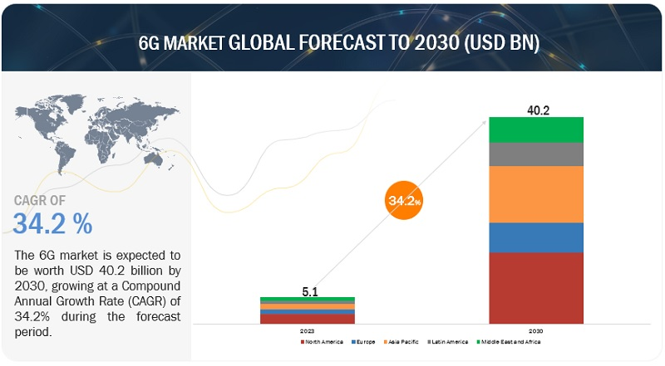
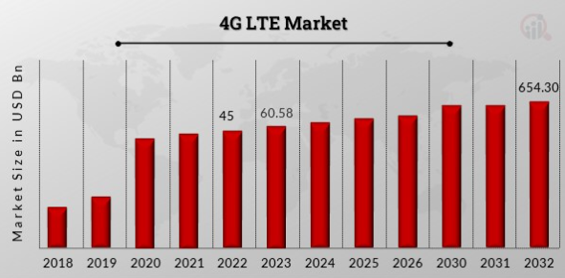
6G : a strategic opportunity for Apple
Very lucrative market :

Slide 6


6G : a strategic opportunity for Apple
Everything to build :
Infrastructures
Chips

Slide 7
6G : a strategic opportunity for Apple
Actual position:
  Recruitment of wireless technologies specialized engineers (not openly said for 6G)
  Member of the “Next G alliance” (2019) => Consortium of North American companies for the development of 6G
    One member in the leadership : Alexander Sayenko, Vice Chair (Spectrum Committee)
  No public declarations about their position about 6G

Slide 8
Conclusion
Blablabla

